Slide 1
Appraisal Updates
UAD 3.6

Slide 2
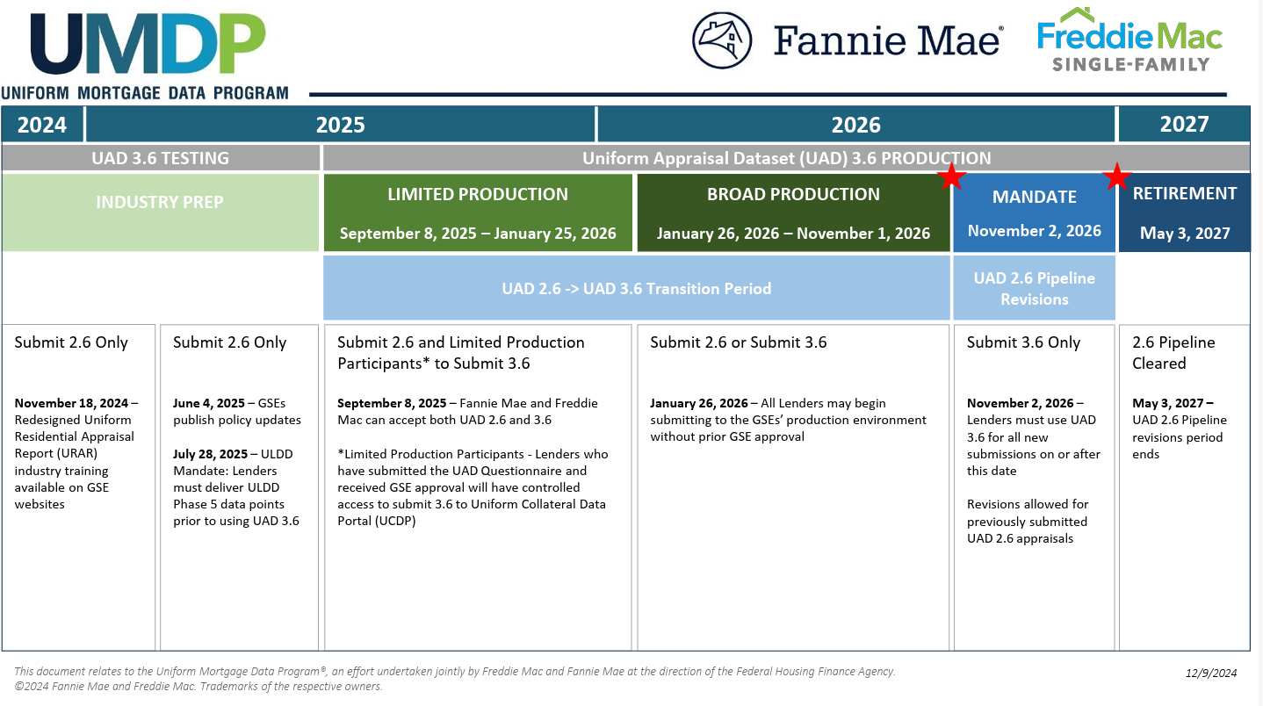
Timeline

Slide 3
Loan origination system updates: ordering
New fields added to support UAD 3.6 ordering
Partner integration updates with read / write capabilities
Handling of the ZIP file
Rent Schedule
UAD 3.6 (indicator)
LandOwnedInCommonIndicator
ValuationAssignmentType
UADConstructionMethodType
UADProjectLegalStructureType
Some partner plan to modify their request types (order type) to match the GSE property valuation ENUMS
Others plan to take a more generic approach to and offer an order appraisal request type
ICE is requesting partners to send three distinct resources for us to store:
  PDF
  XML
  ZIP

Slide 4
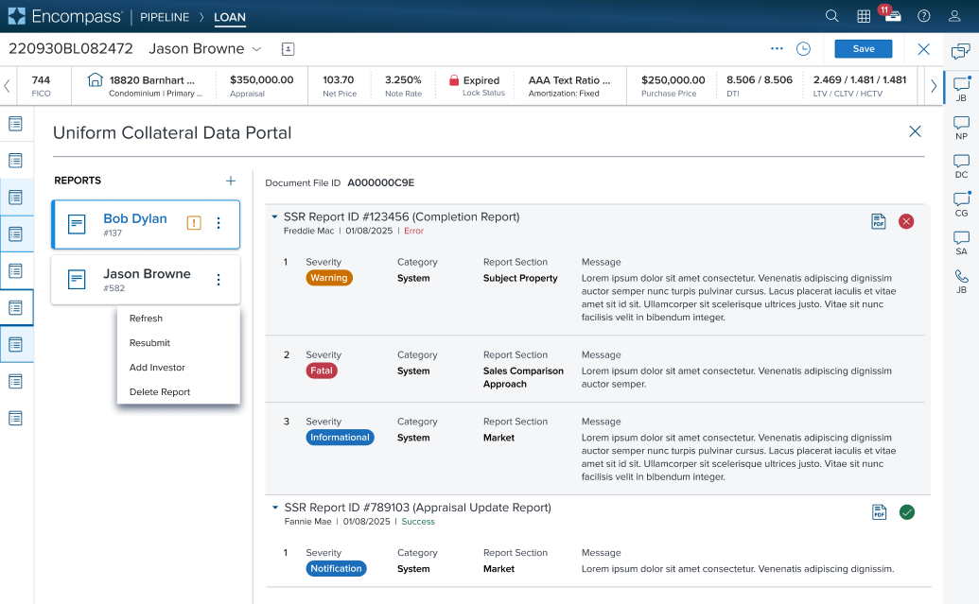
Loan origination system updates: UCDP
Build new UCDP integration to handle delivery of ZIP files to GSEs
    New appraisal report in PDF format
    XML file containing new appraisal data
    Image file (minimum of 1)
The SSR redesign provides more pertinent information; available in PDF and JSON

Slide 5
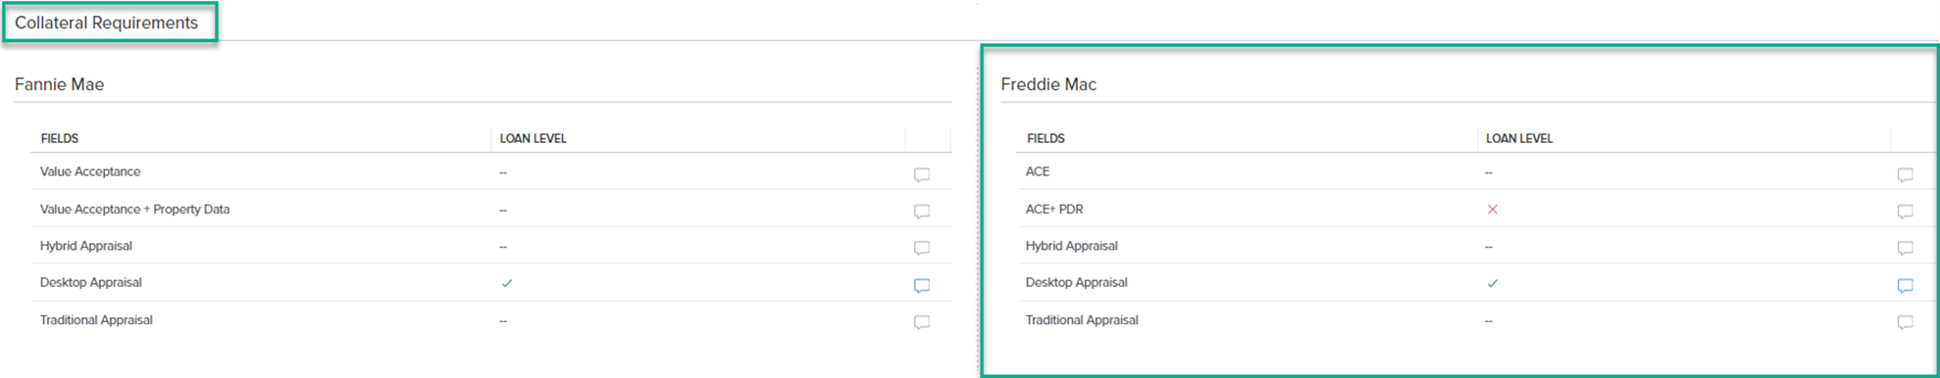

Loan origination system updates: Messages
Ensure any new UAD 3.6 messages returned by AUS are supported and parsed appropriately
Notes:
~ 50 services

Slide 6
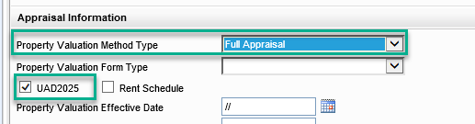
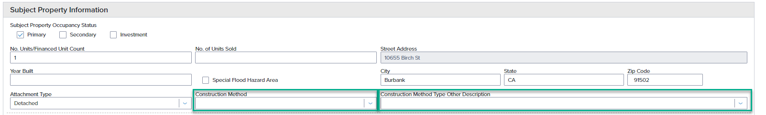
Loan origination system updates: Loan Delivery
The Uniform Loan Delivery Dataset (ULDD) Phase 5 includes new UAD requirements
    Property Valuation Method Type conditionality updated to not send if UAD 3.6
    New Data Point & Enumerations for Construction Method Type Other Description
Notes:
~ 50 services

Slide 7
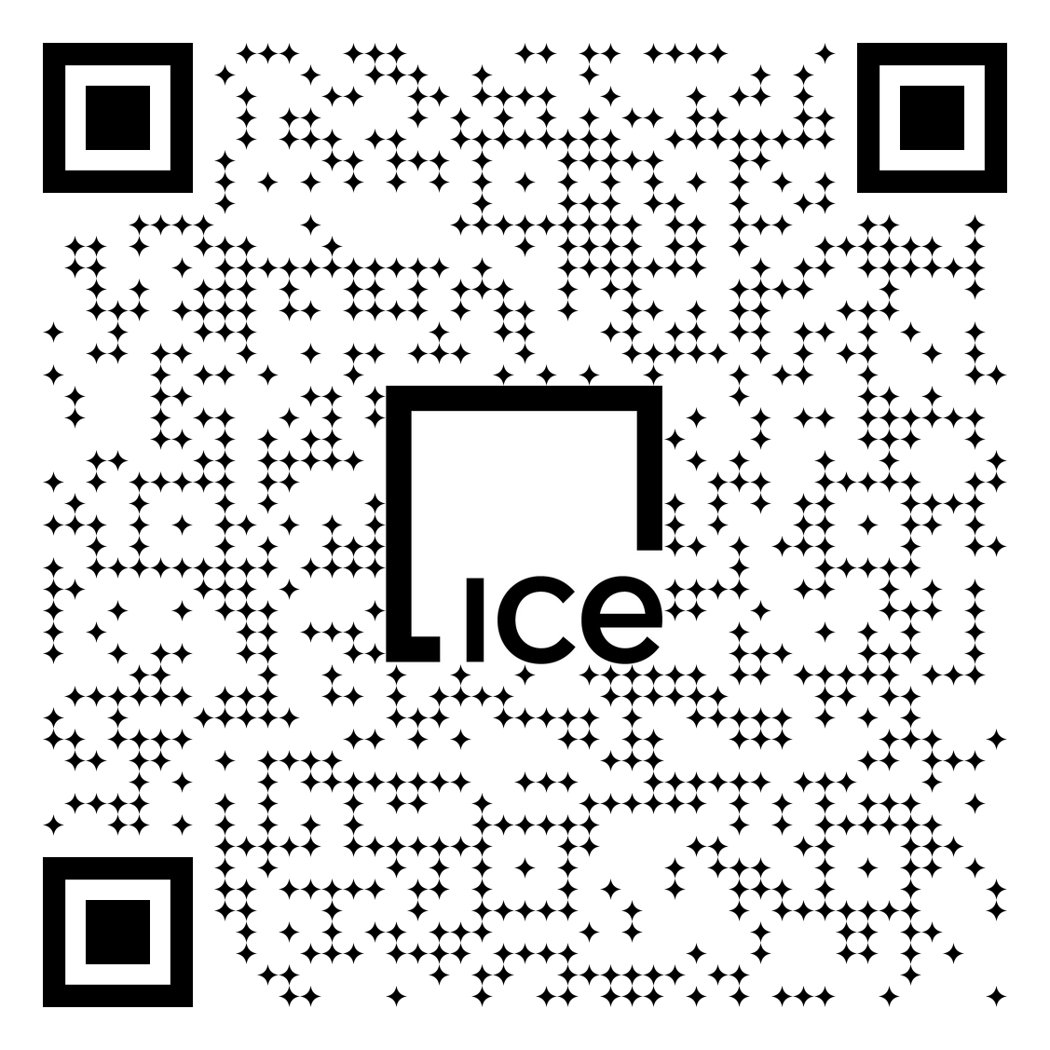
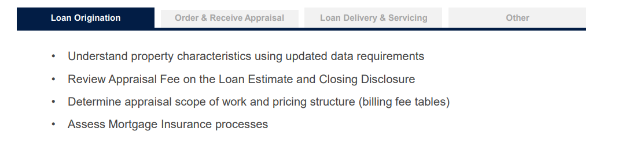
Lender readiness: Loan Origination
Review the GSE lender readiness kit: https://sf.freddiemac.com/docs/pdf/uad-lender-readiness-kit.pdf
Notes:
~ 50 services

Slide 8
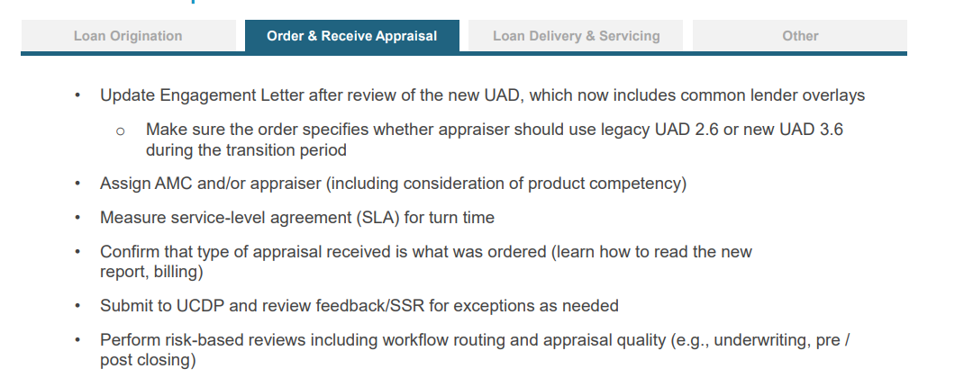
Lender readiness: Order & Receive Appraisal
Review the GSE lender readiness kit: https://sf.freddiemac.com/docs/pdf/uad-lender-readiness-kit.pdf
Notes:
~ 50 services

Slide 9
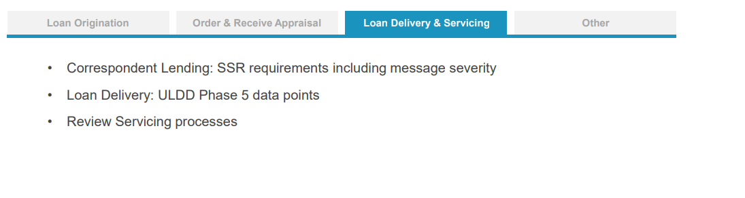
Lender readiness: Loan Delivery & Servicing
Review the GSE lender readiness kit: https://sf.freddiemac.com/docs/pdf/uad-lender-readiness-kit.pdf
Notes:
~ 50 services

Slide 10
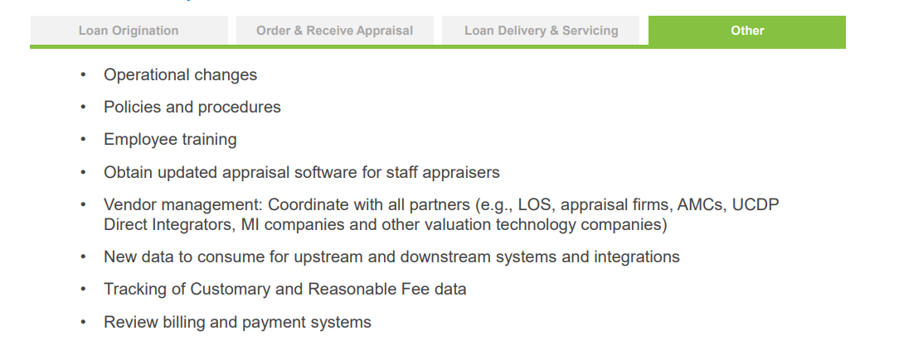
Lender readiness: Other
Review the GSE lender readiness kit: https://sf.freddiemac.com/docs/pdf/uad-lender-readiness-kit.pdf
Notes:
~ 50 services

